Slide 1
Object Oriented Programming CS 115 Dr. Dimitrios Damopoulos

Slide 2
Download material
Presentation
http://tinyurl.com/CS115OOP
Source code
Robot
http://tinyurl.com/CS115OOPRobot
Main
http://tinyurl.com/CS115OOPMain

Slide 3
Using programming languages
So that computers can execute tasks at a great rate
To achieve this, we need an accurate description of the problem
We can easily describe the problem when its a mathematical formula or a specific procedure

Slide 4
Procedure Oriented Programming
Procedural programming creates a step by step program that guides the application through a sequence of instructions
Focuses on the idea that all algorithms are executed with functions and data that the programmer has access to and is able to change

Slide 5

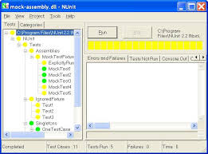
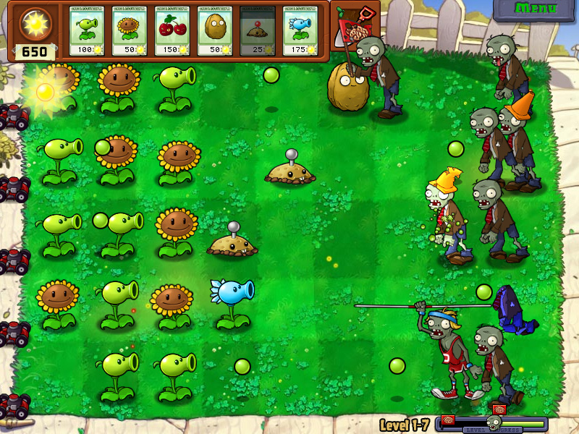
Describing complex problems
What happens when we want to describe complex problems or build graphical applications ?

Slide 6
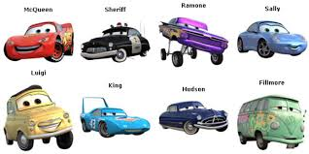
Modeling our problems (1/2)
In a much more similar way on how real world works
Attributes
Model
Year
Speed
Color
Price
Class: Cars
Functionality
Accelerate
Value

Slide 7
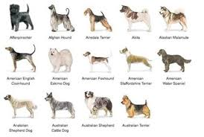
Modeling our problems (1/2)
In a much more similar way on how real world works
Attributes
Name
Age
Type
Number of legs
Has owner
Class: Dogs
Functionality
Sleeps
Eats
Moves
Barks

Slide 8
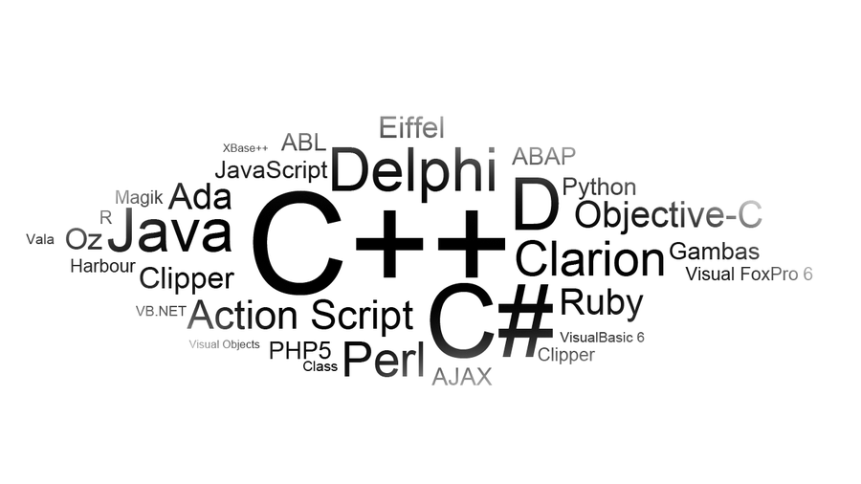
Object Oriented Programming Languages (OOP)
Start of the Story: Late 60's and Early 70's

Slide 9
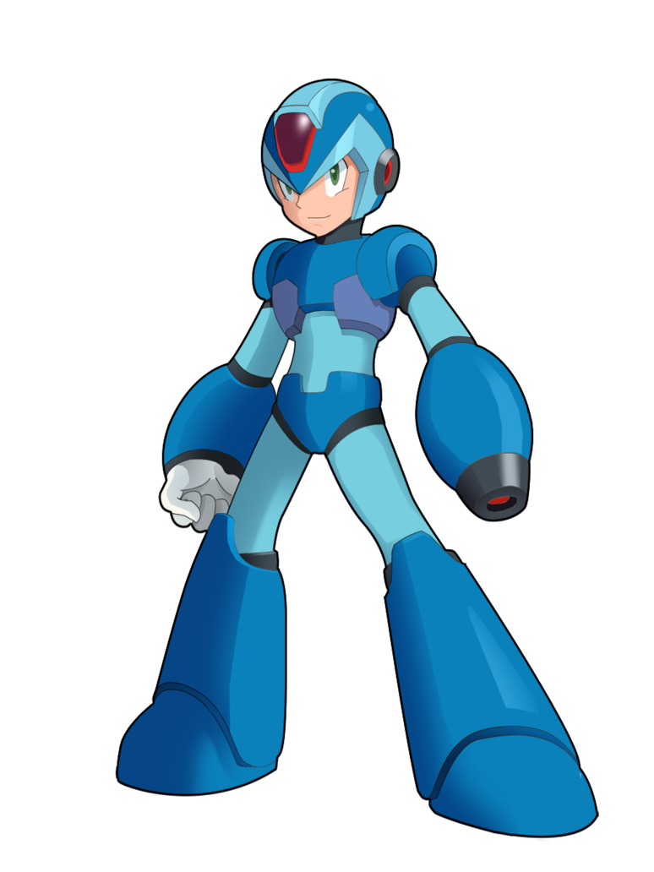



Let’s try to build our own Game! Using OOP
Robots and Robo-Zombies

Slide 10
OOP in Python
Python was built as a procedural/functional program language
OOP exists and works fine!
We need to declare a Class and create an Object of this class

Slide 11
Defining an Object
Object-Oriented programming is analogous to the human brain
Each program is made up of many entities called Objects
Objects are the basic run-time entities in an object-oriented system
An object has state, data, and behavior

Slide 12
Defining a Class
A class is a special data type which defines how to build a certain kind of object
A class contains 2 types of Attributes
Variables – Data attributes that are shared by all the objects of this class
Methods – Responsible for the behavior of an Object
You need to define the class first and then use it to create objects

Slide 13
Defining a Class
Spaceship
Terminator
Megaman
?
Game level

Slide 14
Defining a Class
Spaceship
Robots
Game level

Slide 15
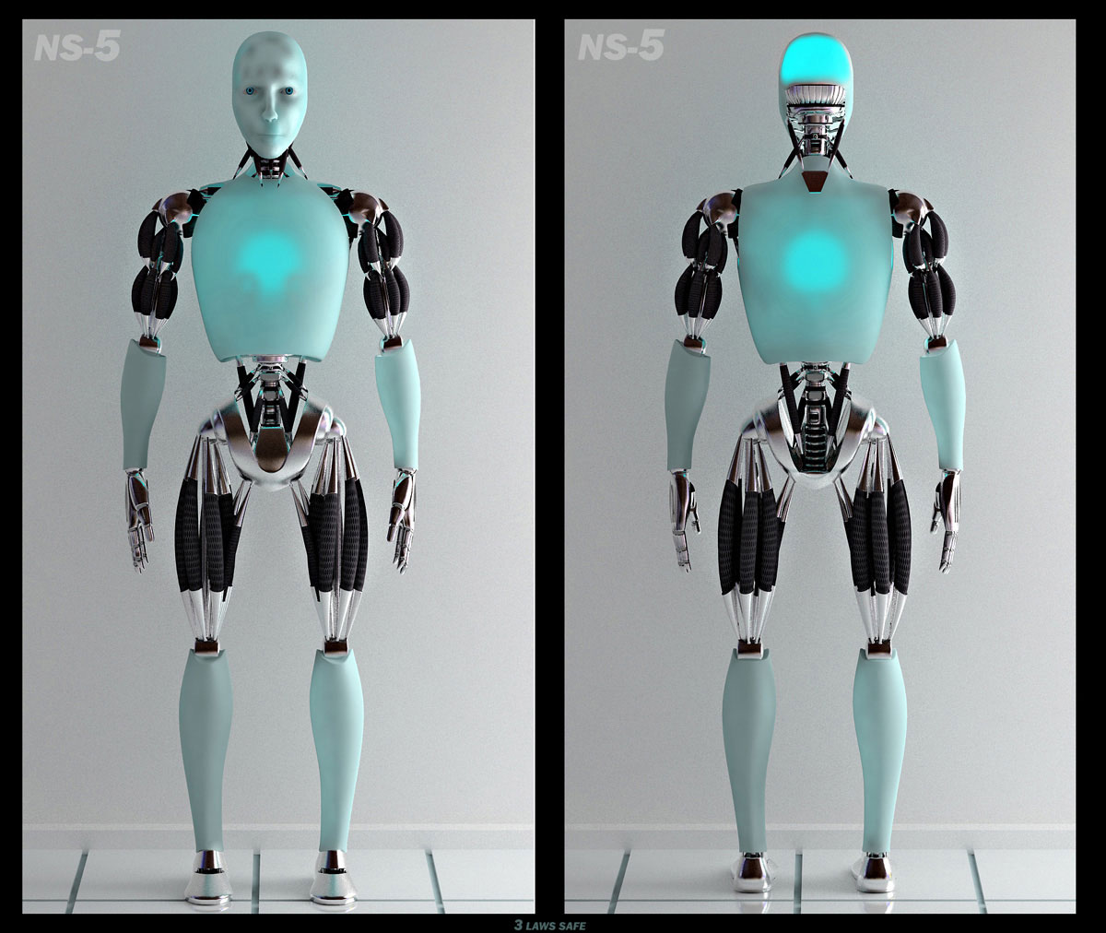
Declaring a class
class ClassName:
statements
statements
…
statements
statements
Robot
class Robot:
Variables
Variables
…
Methods
Methods
…

Slide 16
The Robot class
Robot
Variables
Methods
model
talk
serial number
head
walk
legs
arms

Slide 17
Creating a class Object
Our Class so far
class Robot:
serial_number =0
model= "T1"
head=0
arms=0
legs=0
Creating a class Object
terminator=Robot()
terminator:
is the name of object

Slide 18
Creating more Robots
terminator=Robot()
megaman=Robot()
terminator
megaman
serial_number
model
head
arms
legs
serial_number
model
head
arms
legs
0
0
T1
T1
0
0
0
0
0
0

Slide 19
Accessing the attributes of an Object
To access the class attributes, we need a reference from the Object to the attribute
terminator=Robot()
megaman=Robot()
print "Terminator" + terminator.model
print "Terminator arms" + terminator.arms
print "Megaman" + megaman.model
print "Megaman arms" + megaman.arms

Slide 20
Changing Object values (1/2)
We can directly access and change the values of an Object
terminator=Robot()
megaman=Robot()
terminator.arms=2
print "Terminator arms" + terminator.arms
megaman.arms=1
print "Megaman arms" + megaman.arms

Slide 21
Changing Object values (2/2)
terminator
megaman
serial_number
model
head
arms
legs
serial_number
model
head
arms
legs
0
0
T1
T1
0
0
2
1
0
0

Slide 22
The Robot class
Robot
Variables
Methods
model
talk
serial number
head
walk
set
legs
constructor
arms
get
strings

Slide 23
Writing our first class methods
class methods are defined in the same way as functions do
self is a reference to an empty object
Is empty only for the moment
def talk(self):
print "I am %s with serial number %d" \
% (self.name, self.serial_number)

Slide 24
Calling Methods
We can call the methods of an object in two ways:
1) object.method(parameters)
or
2) Class.method(object, parameters)
terminator=Robot()
megaman=Robot()
terminator.talk()
Robot.talk(megaman)

Slide 25
Set() and Get() methods
We want to change the value of the variable
We want to retrieve the value of the variable
def set_name(self,name):
self.name=name
def get_name(self):
return self.name

Slide 26
Constructors
A constructor is a special method with the name __init__
It is used to initialize the object’s values when the object is created
def __init__(self, parameter, ..., parameter):
statements

Slide 27
Constructor
def __init__(self, model, serial_number, head,arms,legs,distance):
self.model=model
self.serial_number=serial_number
self.head=head
self.arms=arms
self.legs=legs
terminator=Robot(T1, 324, 1, 2, 2)
megaman=Robot(Mega, 444, 1, 1, 2)

Slide 28
Converting objects to string
Printing an object will tells us that it is a reference to Robot object
We need to overload a special method called __str__ to invoke automatically when str or print is called
print megaman
<Robot.Robot instance at 0x105a13248>
def __str__(self):
return string

Slide 29
The spaceship class
Spaceship Name
Consumption()
Fuel tank
Speed
constructor
Pilot
strings
Consumption = fuel tank - 0.5*Speed

Slide 30
An object as an attribute in another class
Pilot

Slide 31
Spacecraft.py
1 2 3 4 5 6 7 8 9 10 11 12 13 14 15 16 17 18 19 20 21 22 23 24 25 | from Robot import * class Spaceship: name="" tank_fuel=1500 speed=100 pilot=None def __init__(self, pilot, tank_fuel, speed, name): self.pilot=pilot self.tank_fuel=tank_fuel self.speed=speed self.name=name C3PO=Robot(234,434,3434,4343,45) falcom=Spaceship(C3PO,2000,360,"Falcon") print falcom.tank_fuel print falcom.pilot.get_name()
Solution: http://tinyurl.com/CS115OOPSpaseship

Slide 32
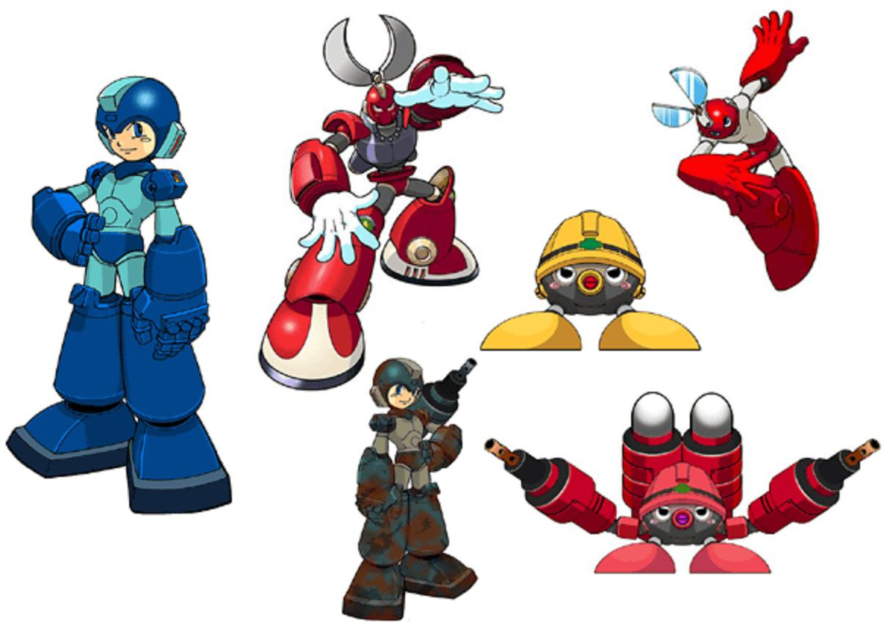

The important idea of Inheritance

Slide 33
Inheritance
Once we construct one class, we can write special versions that inherit all of the methods and attributes of the “parent” or superclass, but also add their own unique features
We can create a large and deep hierarchy of classes
This design methodology empowers great efficiencies in reusing rather than rewriting code

Slide 34
Features of OOP
Ability to simulate real-world event much more effectively
Code is reusable thus less code may have to be written
Data becomes active
Capability to create greater GUI (graphical user interface) applications
Programmers are in position to produce faster, more accurate and better-written applications

